Slide 1

Empowering Growth Beyond Borders

Slide 2

Company Overview
​Established in 1996, Juno Consultants Private Limited has been a trusted partner for businesses seeking comprehensive solutions in finance, accounting, and human resources.
Based in New Delhi, our dedicated team offers a wide array of services, including financial forecasting and planning, management reporting, budgeting, variance analysis, accounts payable and receivable management, audit support, payroll processing, recruitment, and compliance management.
Our commitment to excellence and deep understanding of our clients' needs have enabled us to serve a diverse clientele, including renowned multinational corporations.
At Juno Consultants, we pride ourselves on delivering tailored solutions that drive business success.

Slide 3



OUR PROFESSIONAL SERVICES
Finance
Accounting
At Juno, we offer 360-degree financial solutions designed to function as a complete information system—covering everything from classifying and summarizing to reporting, analyzing, and interpreting your company’s financial performance.
Our goal is to empower informed business decisions by delivering clear insights to all stakeholders
At Juno, maintaining books is just the beginning. Our structured and comprehensive accounting approach covers everything from bank reconciliation and invoicing to final year-end reporting.
We ensure a seamless integration with your existing systems—so all you need to do is review and approve.

Slide 4








FINANCIAL SERVICES
Forecasting & Planning
Management reporting
Board Presentations
Regulatory Compliance
Budgeting
Financial Analysis
Variance Analysis
Virtual CFO

Slide 5








ACCOUNTING SERVICES
Accounts Payable
Accounts Receivable
Audit Support
Asset Register
Bank Reconciliation
Credit Card Reconciliation
General Ledger Accounting
Payroll Accounting

Slide 6







We use the right software for your business
Quickbooks provides solutions to manage sales and expenses, and keep track of all daily business B transactions.
No matter what industry you operate in, Sage has the financial management package that will strengthen your accounting processes.
Deltek Vision is a game-changer when it comes to accounting software. Deltek delivers software and information solutions that enable superior levels of project intelligence, management and collaboration.
Zoho Books, a comprehensive online accounting software tailored for businesses of all sizes. Zoho Books streamlines your financial operations, offering an array of features designed to make accounting simple.
Xero is streamlined, cloud-based accounting software that connects you to accountants, bookkeepers, banks and business advisors.
TallyPrime provides a detailed audit trail of all transactions. It logs edits such as creation, alteration, or deletion of records, complete with timestamps.
SAP facilitates information flow and data processing across all parts of your business. You can find SAP modules designed for different parts of an enterprise, ranging from finance to supply chain management

Slide 7



Our Expertise
Industry Knowledge
Tailored Solutions
Data-Driven Insights
We harness the power of advanced analytics to drive smarter, data-backed decision-making for our clients. By transforming complex data into clear insights, we empower businesses to identify opportunities, mitigate risks, and make strategic choices with confidence.
Our team of seasoned professionals brings cross-industry expertise—spanning sectors such as technology, manufacturing, healthcare, financial services, and retail—enabling us to deliver tailored, effective solutions for diverse business needs.
Juno Consultants delivers tailored solutions designed to meet your unique business challenges with precision & expertise.
Our approach combines deep industry expertise with understanding of your needs, enabling us to design strategies that drive efficiency, growth, & long-term value.

Slide 8





Specialized Financial Expertise
Clients trust us for our deep knowledge in finance and accounting. We consistently deliver high-quality, reliable services that provide exceptional value.
Uncompromising Quality Standards
We maintain the highest standards across all advisory services. No matter the size or complexity of the project, we deliver efficient, tailored solutions through a flexible and cost-effective model designed to meet unique client needs.
Proven Industry Experience
Our services support a wide range of industries, including wholesalers, distributors, manufacturers, merchants, and retailers. With over 100 years of combined experience, we bring unmatched insights and practical expertise to every engagement.
Scalable and Diverse Solutions
We work with organizations of all sizes, including enterprises with over 1000 employees. Our team brings together a wide array of skills essential for delivering strategic results across both national and international markets.
Why Choose
Us

Slide 9


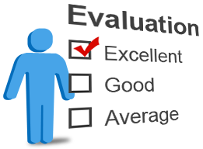


Client Success Stories
Operational Cost Reduction
Revenue Increase
Client Testimonials
We specialize in identifying and implementing strategic initiatives to drive significant operational cost reduction without compromising quality or performance. By partnering with us, organizations can uncover hidden inefficiencies, reduce overheads, and build a leaner, more agile business model that supports long-term growth.
We empower businesses to unlock their full revenue potential through data-driven strategies and innovative growth solutions. With a deep understanding of industry dynamics and customer behavior, we craft tailored plans that help our clients accelerate revenue generation and achieve measurable business outcomes.
Our success is best reflected in the words of our clients. Their testimonials highlight not just our expertise, but also the trust and long-term partnerships we build. These stories of transformation and value creation are a testament to the commitment and excellence we bring to every engagement.

Slide 10

Core Team
Name | Qualifications | Experience
Nitin Mittal | B. Com (H), FCA, MBA, LLB (Chartered Accountant & Lawyer) | 25 Years +
Dinesh Kumar | B.COM, FCA, LLB, DISA, FAFD (Chartered Accountant & Lawyer) | 25 Years +
Tapan Mandal | B. Com (H), ACA (Chartered Accountant) | 5 Year+
Niraj Soni | B. Com (H), ACA (Chartered Accountant) | 2 Year+
Nisha Adwani | B. Com(H), ACS (Company Secretary) | 3 Year+

Slide 11

Team & Infrastructure
Our team is represented by mix of senior advisors having vast industry experience and young & dynamic executives who work beyond time limits to ensure you the right candidate at the right time.
Our team assists clients with business and strategic planning, internal controls, and increasing operating efficiency.
Our expert team is handling and responsible for finance and accounting function of domestic and international clients.
Our expert team have wealth of experience in handling accounting process migration and has been involved in migration of several processes.
Our expert team have vast knowledge international taxation and related compliances.
We have a fully air-conditioned modern office with spacious workstations, library bank, separate cabins for seniors , state of the art conference room equipped with video conference system, HD projector etc.
We have our own servers, VPN, Firewall for data security, power backups, multiple data connectivity etc. for uninterrupted delivery.

Slide 12
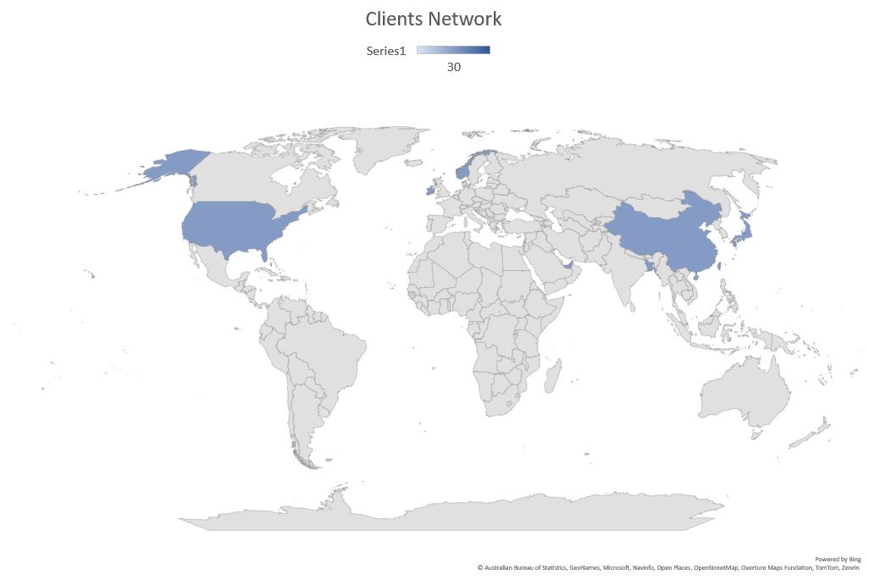
World-Wide Clients Network
USA
CHINA
JAPAN
NORWAY
IRELAND
TAIWAN
BANGLADESH
UAE

Slide 13

































Our Valued Clients

Slide 14




Contact Information
Website
Email
https://www.junoconsultants.org
nitin@junoconsultants.in
Address
Phone
C-21B, South Extension -1,
New Delhi-110049, India
+91 981 014 7514 , +91 11 410 2390
+1 914 210 0748

Slide 15
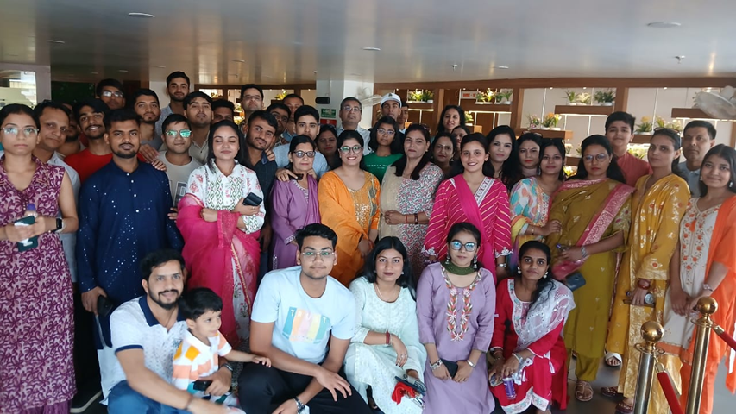
THANK YOU

